Slide 1
Floods on the rise: keep calm and reinsure
Dr Caroline Bell
Legal Director – Client Knowledge Services

Slide 2
Floods on the Rise - Worldwide
Working Group II IPCC’s fourth Assessment Report: no general trend
Sigma report:
2015: 55 floods worldwide – insured loss: US$4.3m
2014: 61 floods worldwide – insured loss: US$2.1m
2013: 53 floods worldwide – insured loss US$9.1m
Lloyd’s City Risk Index (2015-2025): total GPD at risk in 321 cities is $432.01bn
Severe convective storms (tornadoes, hail, thunder, lightning, heavy rainfall and flash floods)

Slide 3
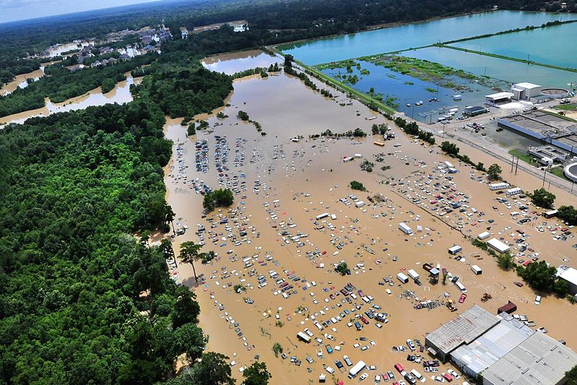
Floods on the Rise - Worldwide
Aerial view of flooding near Baton Rouge
Photo by US Department of Agriculture
August 2016 Louisiana, US
"historic, unprecedented flooding event“ (Louisiana's governor, John Bel Edwards)
30,000 people evacuated and 146,000 homes damaged
2013 severe monsoon floods in India
2011 Thai floods: 13.6 million people affected

Slide 4
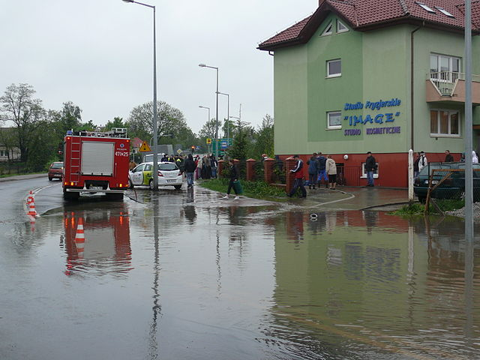
Floods on the Rise – Europe (1)
1980 – 2010: 3,563 floods in 37 European countries
Peak in 2010: 321 floods affecting 27 countries
2013 summer floods: biggest flood-induced loss in Europe ever
June 2016: flash floods
2050: flood losses expected to have increased fivefold
Flooding in Poland 2010 (photo by Kolanin)
June 2016 floods in France (photo by Reuters)

Slide 5
Floods on the Rise – Europe (2)
Source: European Environment Agency
Last updated: May 2016

Slide 6
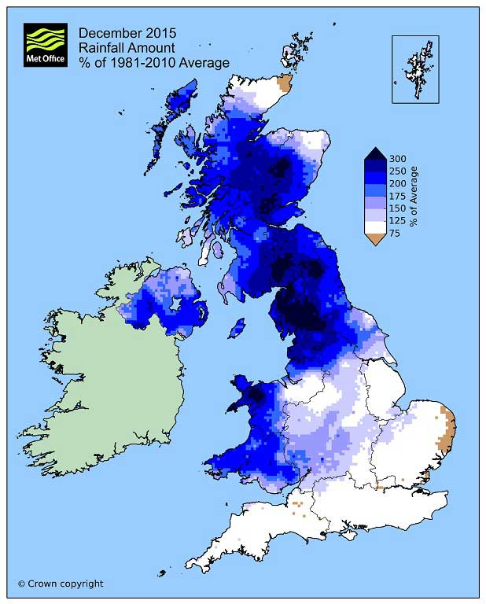
Floods on the Rise - UK
5 out of 6 of the wettest years all recorded since 2000 (records started in 1910)
1 in 6 homes in England & Wales estimated at risk of flooding
Annual flood damage: £1.1bn across England & Wales
December 2015 storms Desmond (5/12), Eva (25/12) and Frank (30/12)
Total pay-out by insurers: £1.3bn

Slide 7
Floods and Insurance - UK
Households cover mostly provided by “buildings and contents” insurance
Commercial cover provided by “property”, “All Risks” insurance, Business Interruption …
Specialist flood insurance policies can be obtained to cover all types of floods
Reinsurance: property catastrophe re/insurance, ILS products (e.g. collateralised reinsurance and catastrophe bonds)

Slide 8
Floods and Insurance – problem areas (1)
The uninsurable risk
Pricing
ABI “statement of principles” requires insurers to:
offer flood cover for domestic properties and small businesses as a if the flood risk is not significant
offer flood cover to existing domestic property and small businesses at significant flood risk providing the Environment Agency has announced plans reduce the risk within five years.
How about new builds, large businesses, high risk areas with no plan?

Slide 9
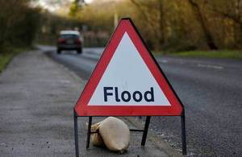
Flood and Insurance – problem areas (2)
What is covered?
Inundation caused by severe weather (storm, tempest and flood)
Riverine flooding
Storm surge
Flash floods
Water ingress over several days
Water damage caused by negligence (e.g. leaking pipe)

Slide 10
Risk Mitigation strategies (1)
Invest in flood defences
Let the market decide e.g. Italy
Let the consumer decide e.g. UK
Compel insurers to provide cover e.g. France/Belgium
Insurance administered by the government e.g. US (National Flood Insurance Program)

Slide 11
Risk Mitigation strategies – Flood Re (1)
What is it?
Result of lengthy consultations between industry and government
Opened for business in April 2016
Scheme that allows insurers to reinsure flood risk
Not-for-profit organisation managed by insurers but accountable to Parliament
Only intended to cover properties most at risk of floods

Slide 12
Risk Mitigation strategies – Flood Re (2)
Funded by:
Levy on household insurers based on market share (£180/year); and
Reinsurance premium capped based on Council Tax bands
Limitations:
Insurers not compelled to pass on premium reduction onto their customers
Funding subject to review every 5 years
Temporary solution: due to last 25 years only

